Slide 1

tractortek
Data Analytics Capstone 1
Presented by: Hannah McElroy
4/14/2021

Slide 2

Introduction
Created a Store Sales Decision Support System for TractorTEK:
Built a web app UI for data entry of weekly sales​
Created a sales dashboard with analysis findings​
Designed the back end and a database design​
Hannah McElroy

Slide 3
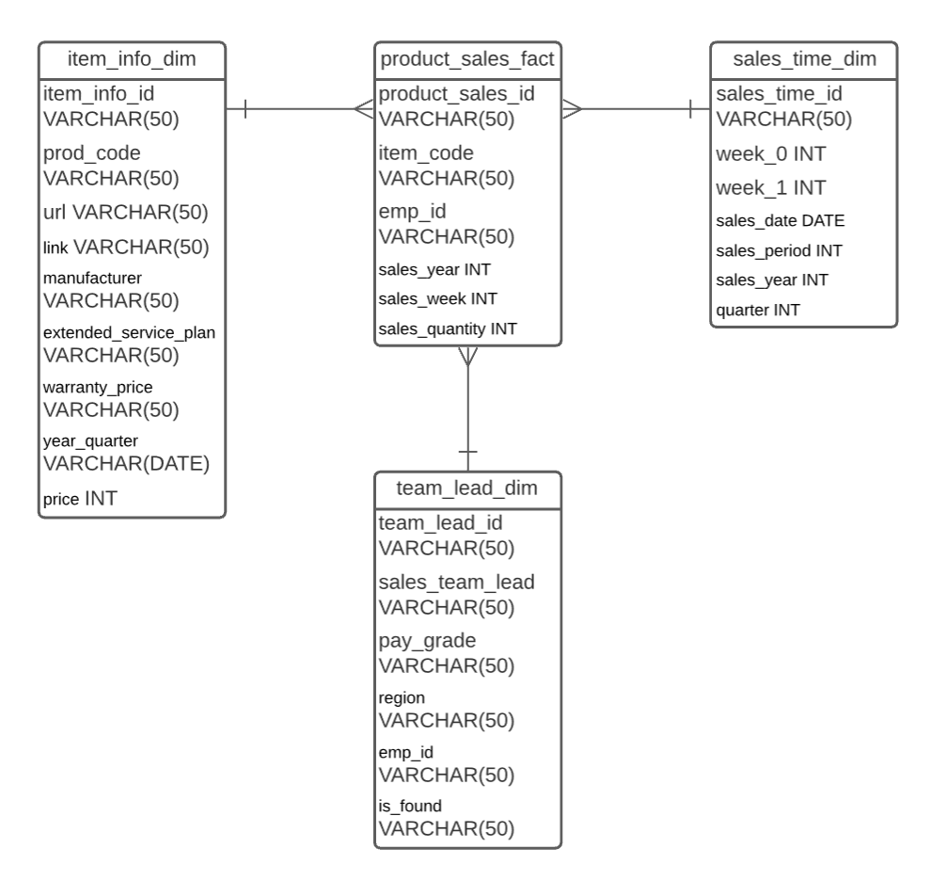
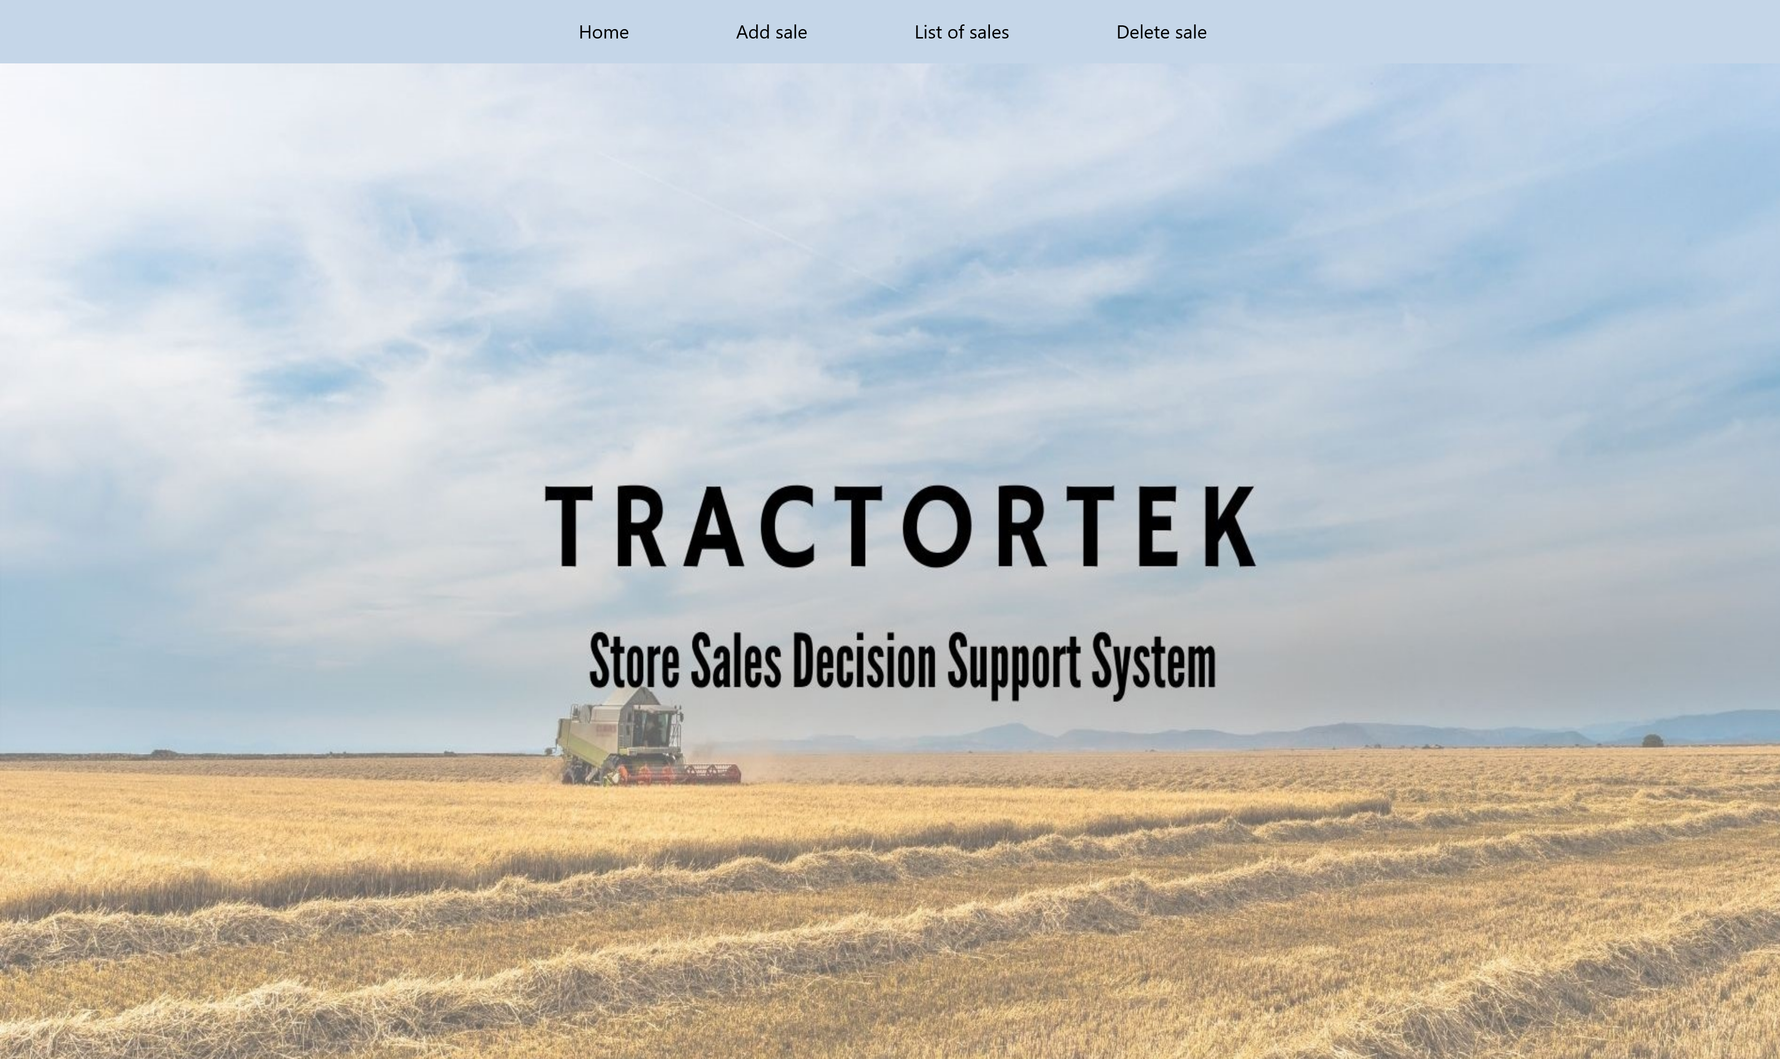
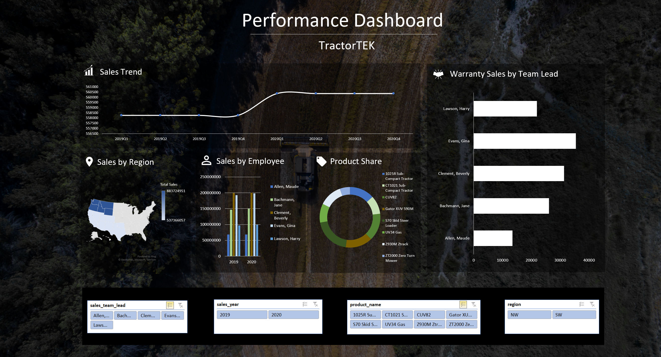
Presentation Agenda
Web App -> Dashboard -> Database Design

Slide 4
Web App
Data Entry
User Interface friendly web app focused on data entry
Home, Add sale, List of sales, Delete sale
Each data entry is loaded on the backend database
Click here

Slide 5
Performance Dashboard
Analytics
Sales Trend
Sales by Region
Sales by Employee
Product Share
Warranty Sales by Team Lead
Click here

Slide 6
Database Design
EERD
Factual Table
Product Sales
Dimensional Table
Item info
Sales time
Team lead
Click here

Slide 7
Jupyter
Dataframes
Programmed data frames to capture the backup data from MySQL
Pandas, PyMySQL, SQLAlchemy
Check consistency throughout columns

Slide 8
Future Opportunity
TractorTEK
Add on to the website Add products, bring in drop-down list, modern design
Elevate the database design Create an interactive EERD to visualize how each attribute is related
Build data frames using Python Jupiter Would grab data from SQL Workbench using Pandas

Slide 9
Thank you
Hannah McElroy

